Slide 1
The Constitutional
Powers of Government
Federal Form of Government:
  Shares power between national and state governments.
  National government has limited, enumerated powers delegated from States.

Slide 2
The Constitutional
Powers of Government
Federal Form of Government (cont’d).
  10th Amendment: powers reserved to the states and to the people.
  Police Powers: order, safety, morals.

Slide 3
The Constitutional
Powers of Government
The Separation of Powers.
  Three branches that provide checks and balances:
    Legislative (Congress): Creates laws.
    Executive (President/Agencies): Enforce laws.
    Judicial (Federal Courts): Interprets laws.

Slide 4
The Constitutional
Powers of Government
The Commerce Clause.
  Power to regulate interstate commerce defined in Gibbons v. Ogden (1824): activities that “substantially affect interstate commerce.” →

Slide 5
The Constitutional
Powers of Government
The Commerce Clause.
  Expansion of National Powers.
    In 1942, Supreme Court expanded commerce clause as to what constitutes impact on interstate businesses (Wickard v. Filburn).
    In 1964, Supreme Court prohibited racial discrimination in interstate commerce (Heart of Atlanta Motel v. U.S.).

Slide 6
The Constitutional
Powers of Government
The Commerce Clause.
  Commerce Clause Today.
    National government can regulate virtually any business enterprise, including those that are internet-based. Limits: U.S. v. Lopez (1995).
    What about medical marijuana and the commerce clause?

Slide 7
The Constitutional
Powers of Government
The Commerce Clause
    State police powers or regulations that substantially interfere with interstate commerce will be struck down.
    FAMILY WINEMAKERS OF CALIFORNIA V. JENKINS (2010). Did the State of Massachusetts discriminate against out-of-state wineries?

Slide 8
The Constitutional
Powers of Government
The Supremacy Clause.
  In case of direct conflict between state and federal law, state law is invalid.
  A valid federal statute or regulation will take precedence over a conflicting state or local statute. →

Slide 9
Business and the Bill of Rights
First Ten Amendments to the United States Constitution=Bill of Rights.
Apply to natural persons and most apply to business entities as well.

Slide 10
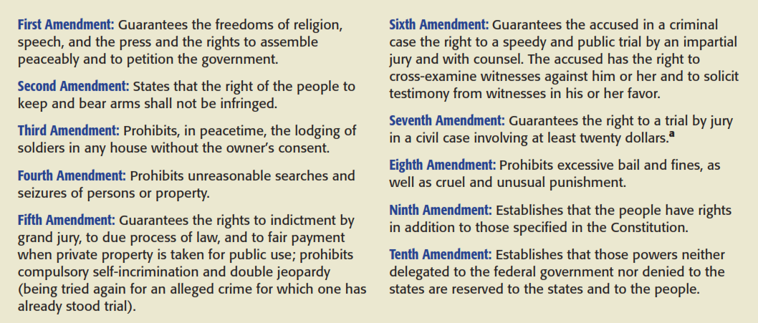
The Bill of Rights

Slide 11
Business and the Bill of Rights
Limits on Federal and State Government Actions.
  Bill of Rights originally intended to limit national government powers.
  Today, Bill of Rights is applied to States via the “due process” clause of the 14th Amendment.

Slide 12
Business and the Bill of Rights
The First Amendment – Freedom of Speech.
  Afforded highest protection by courts.
  Symbolic Speech: Texas v. Johnson (1989), the “flag burning” case. →

Slide 13
Business and the Bill of Rights
The First Amendment – Freedom of Speech.
  Reasonable Restrictions.
    Balance between a government’s obligation to protect its citizens versus a citizen’s right to speech.

Slide 14
Business and the Bill of Rights
The First Amendment – Freedom of Speech.
  Corporate Political Speech.
    Political speech by corporations is protected by the First Amendment.
    In Citizens United v. Federal Election Commission (2010) the Supreme Court ruled that corporations can spend freely to support or oppose candidates for President and Congress.

Slide 15
Business and the Bill of Rights
The First Amendment – Freedom of Speech.
  Commercial Speech.
    Courts give substantial protection to commercial speech (advertising).
    Restrictions must: Implement substantial government interest; directly advance that interest; and go no further than necessary. →

Slide 16
Business and the Bill of Rights
The First Amendment – Freedom of Speech.
  Commercial Speech.
    BAD FROG BREWERY, INC. V. NEW YORK STATE LIQUOR AUTHORITY (1998). Did the State unconstitutionally restrict commercial speech when it prohibited a certain gesture (illustration) on beer labels?

Slide 17
Business and the Bill of Rights
The First Amendment – Freedom of Speech.
  Unprotected Speech: certain types of speech are not protected by the First Amendment: slander, fighting words, pornography.
      Obscenity (see Miller v. California).
      Online Obscenity: CDA, COPA, Children’s Internet Protection Act, Children’s Internet Protection Act (2000).

Slide 18
Business and the Bill of Rights
The First Amendment – Freedom of Religion.
  Government may not “establish” a religion or prohibit the “free exercise” of religion.
  The Establishment Clause: bars government from establishing a state-sponsored religion, or passing laws that favor one over the other. →

Slide 19
Business and the Bill of Rights
The First Amendment – Freedom of Religion.
  The Establishment Clause.
    TRUNK V. CITY OF SAN DIEGO (2011). What was the Supreme Court’s rationale for ordering the cross removed?

Slide 20
Business and the Bill of Rights
The First Amendment – Freedom of Religion.
  Free Exercise Clause: First Amendment guarantees the “free exercise” of religion.
    Employers must reasonably accommodate beliefs as long as employee has sincerely held beliefs.

Slide 21
Due Process and Equal Protection
Fifth and Fourteenth Amendments provide “no person shall be deprived of life, liberty or property without due process of law.”
Due Process: Procedural and Substantive issues. →

Slide 22
Due Process and Equal Protection
Due Process.
  Procedural Due Process: procedures depriving an individual of her rights must be fair and equitable.
    Constitution requires adequate notice and a fair and impartial hearing before a disinterested magistrate.

Slide 23
Due Process and Equal Protection
Due Process.
  Substantive Due Process: focuses on content or substance of legislation.
    Laws limiting fundamental rights (speech, privacy, religion) must have a “compelling state interest.”

Slide 24
Privacy Rights
Fundamental right not expressly found in the constitution, but derived from First, Fifth and Fourteenth Amendments.

Slide 25
Privacy Rights
Federal Statutes Affecting Privacy Rights.
  “Pretexting” for financial information is illegal under Gramm-Leach-Bliley.
  Privacy Act of 1974.
  Medical Information: HIPAA of 1996.
  USA PATRIOT Act of 2001.

